Slide 1
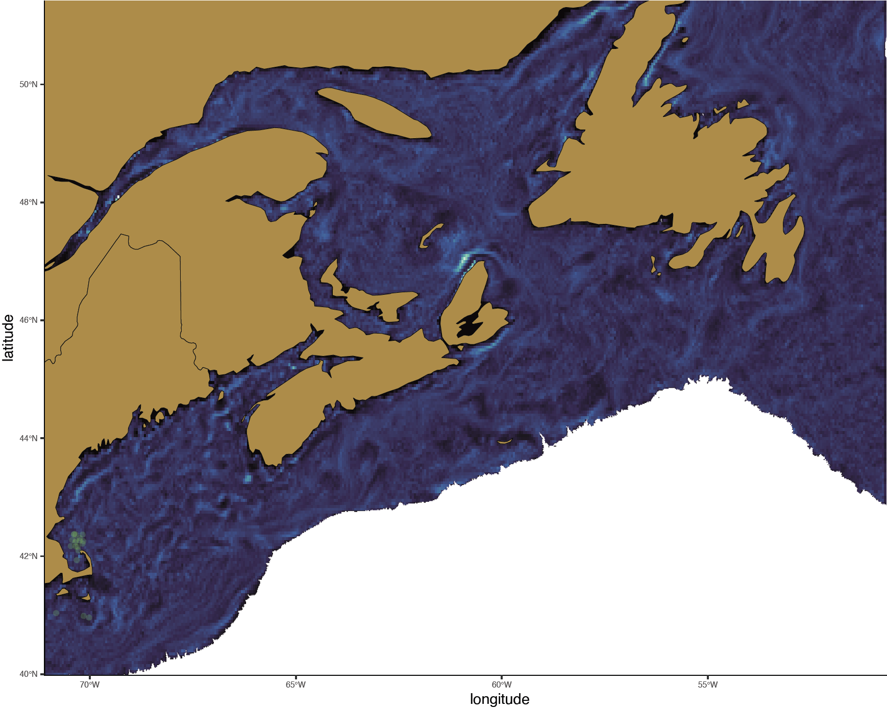
2018
April - 06
Young C. finmarchicus

Slide 2
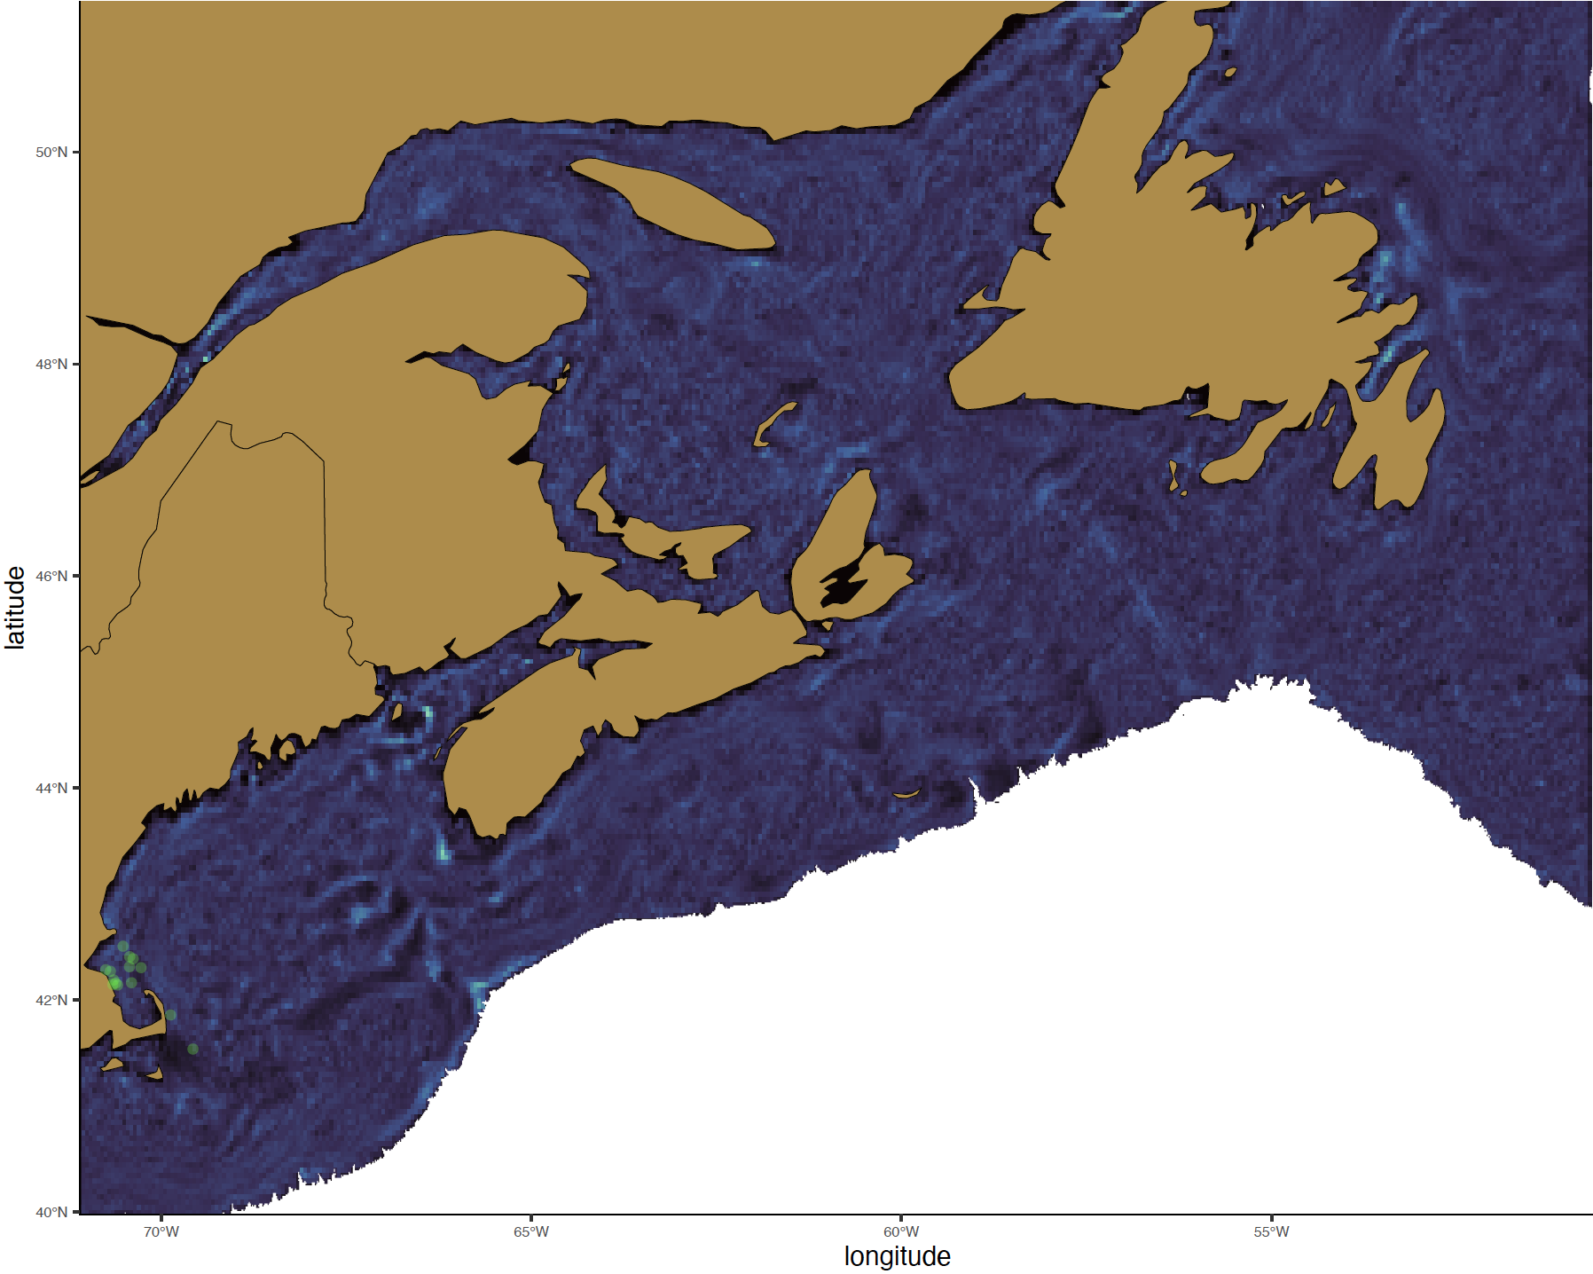
2018
April - 14
Young C. finmarchicus

Slide 3
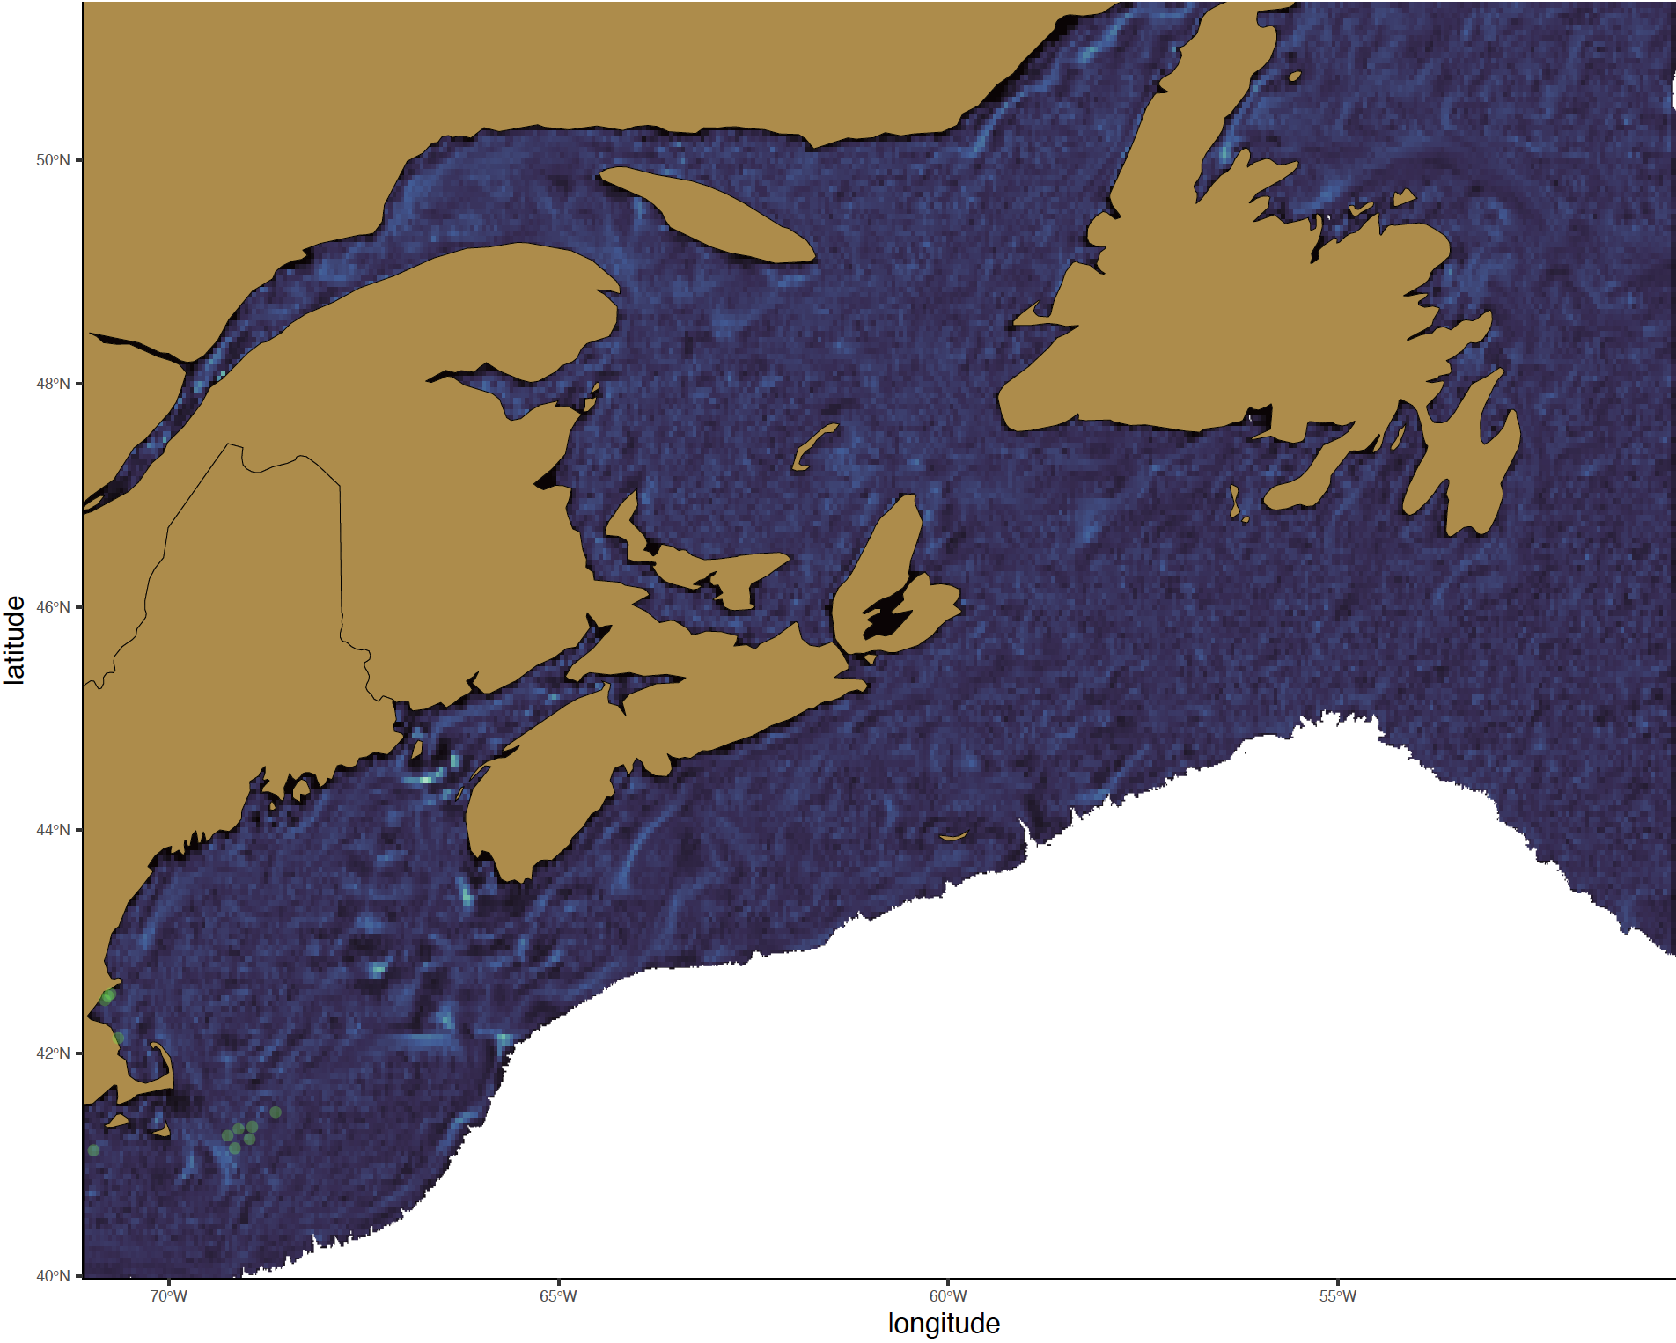
2018
April - 22
Young C. finmarchicus

Slide 4

2018
April - 30
Young C. finmarchicus

Slide 5
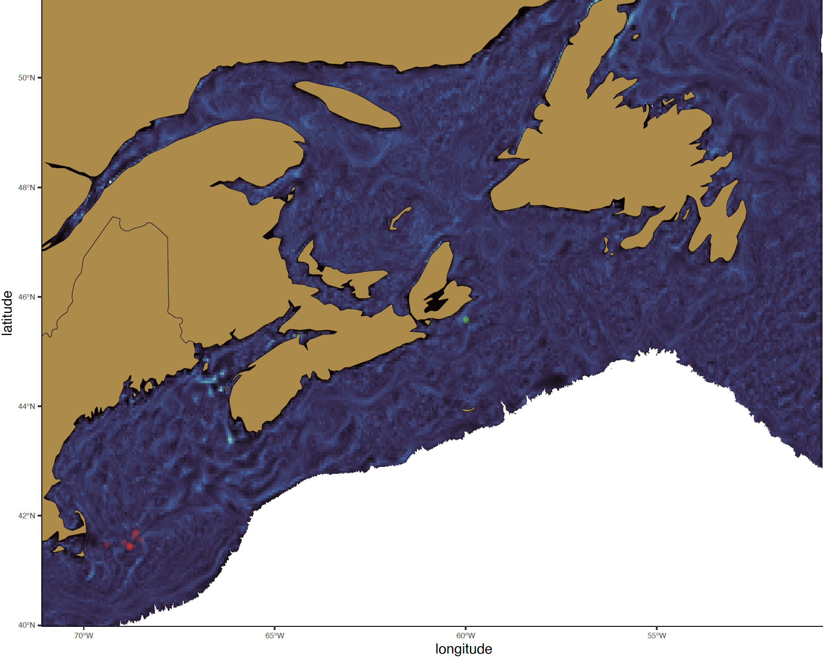
2018
May - 08
Young C. finmarchicus

Slide 6
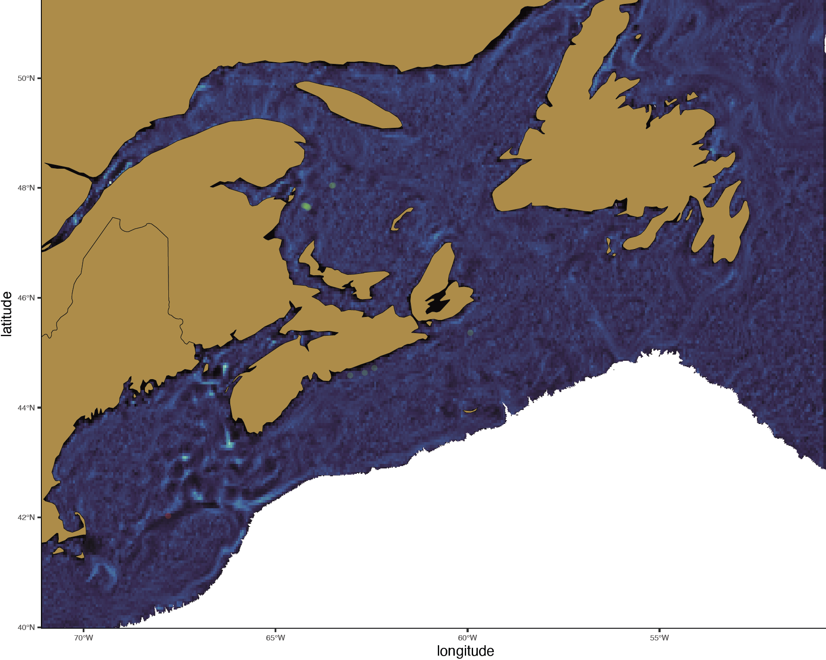
2018
May - 16
Young C. finmarchicus

Slide 7
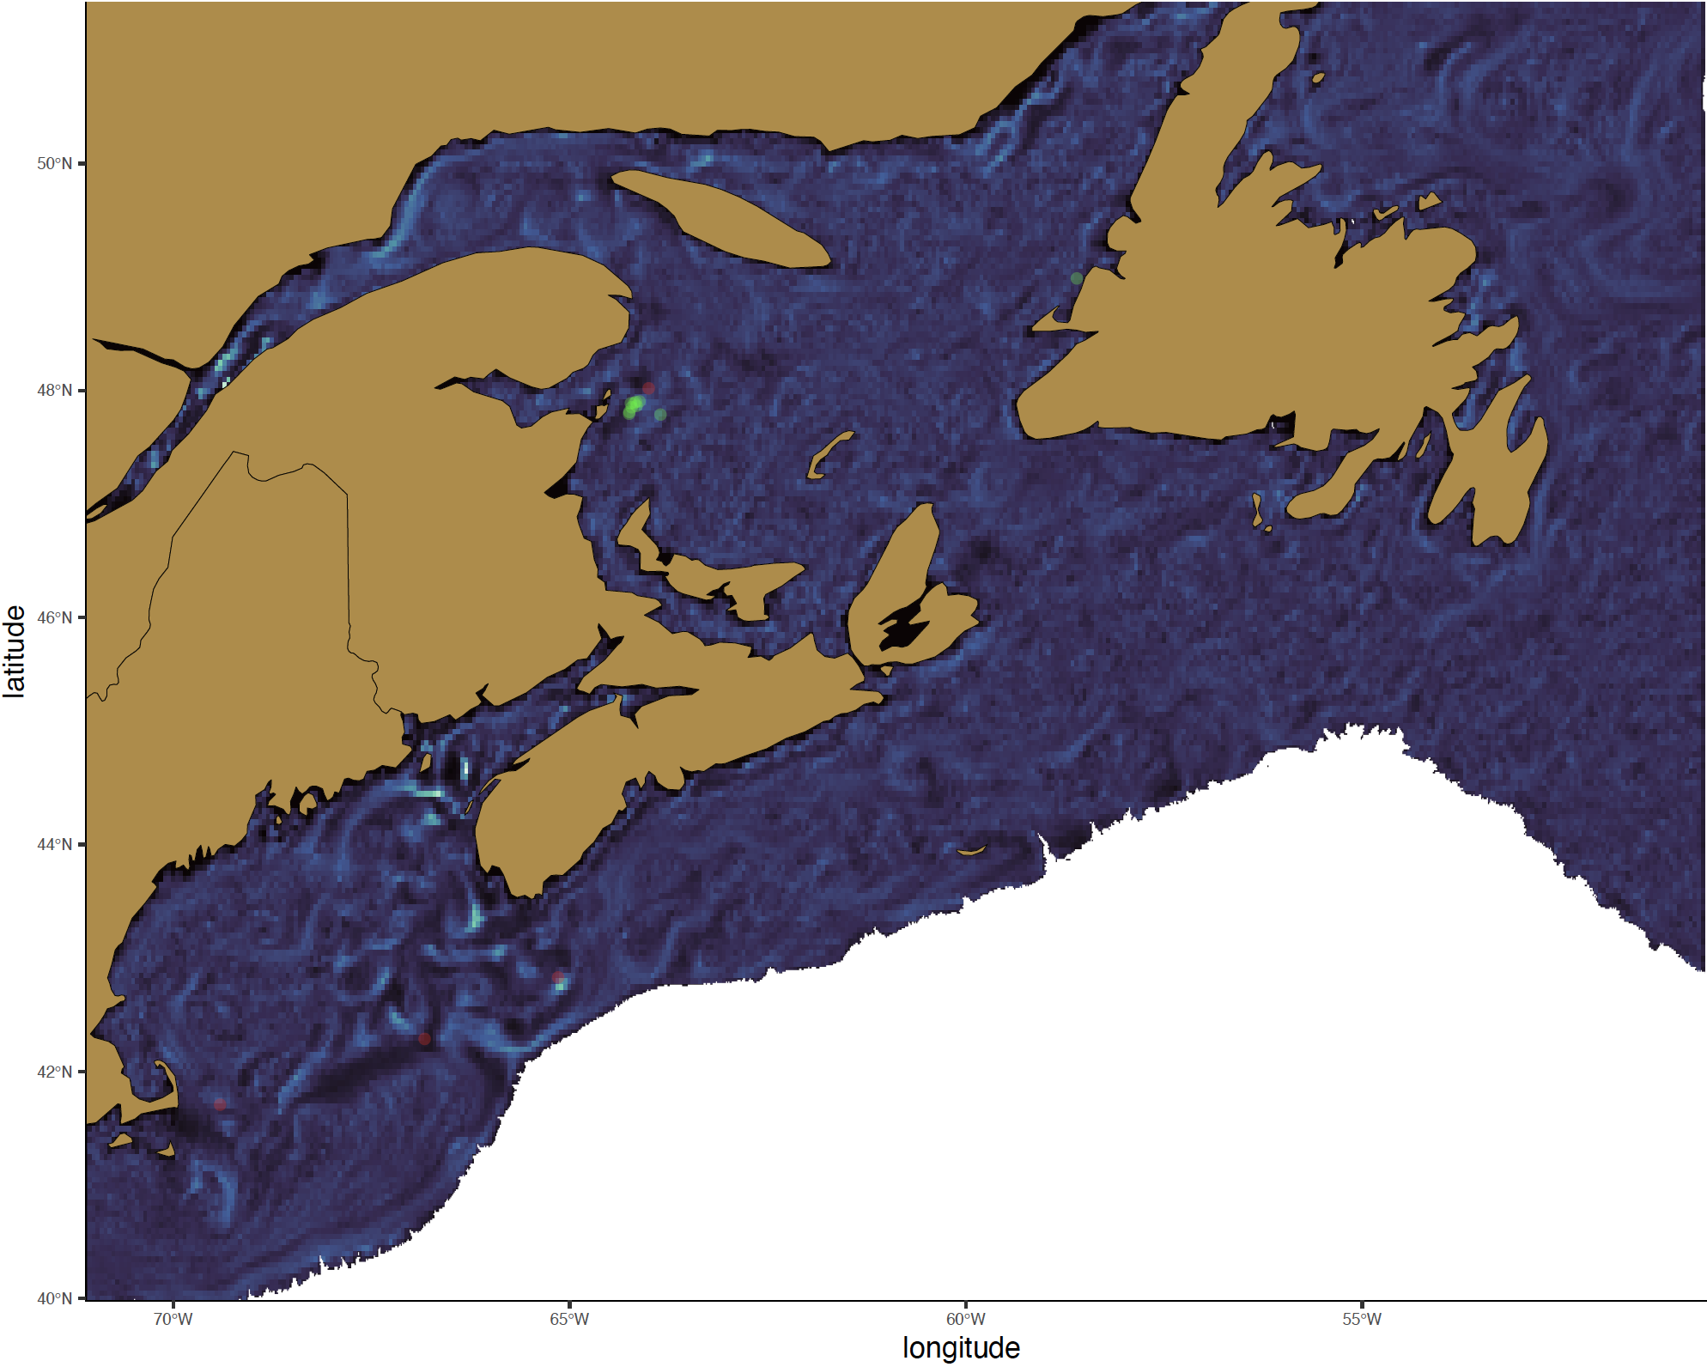
2018
May - 24
Young C. finmarchicus

Slide 8
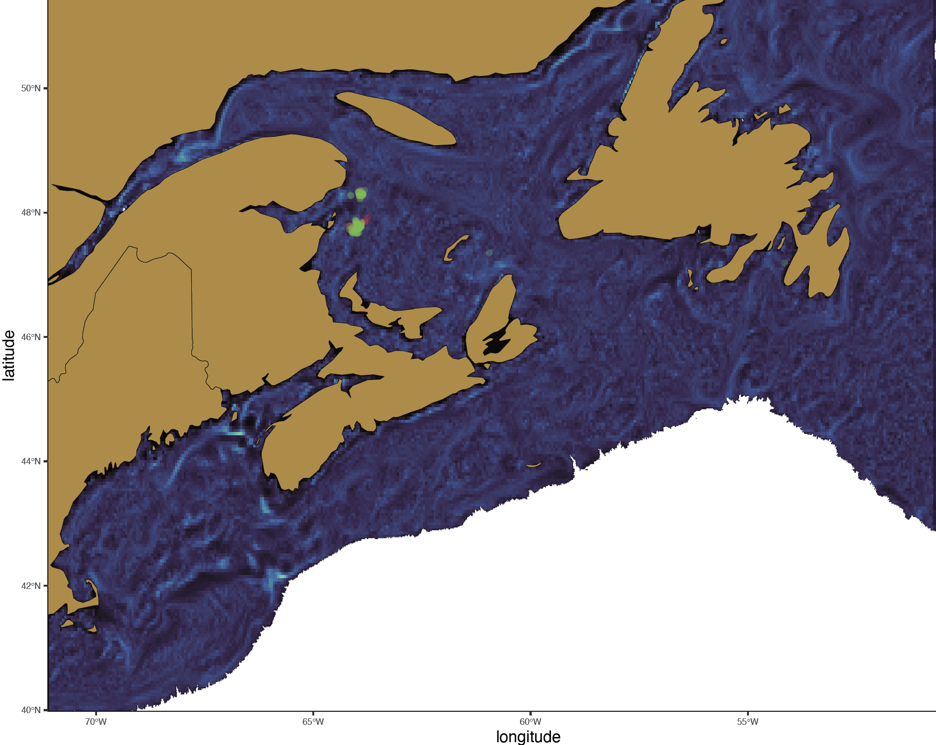
2018
June - 09
Young C. finmarchicus

Slide 9
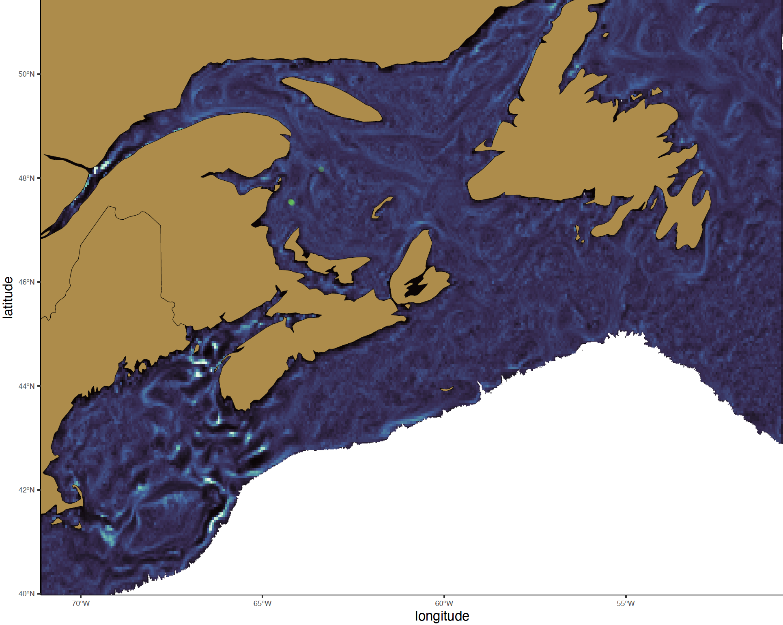
2018
June - 17
Young C. finmarchicus

Slide 10
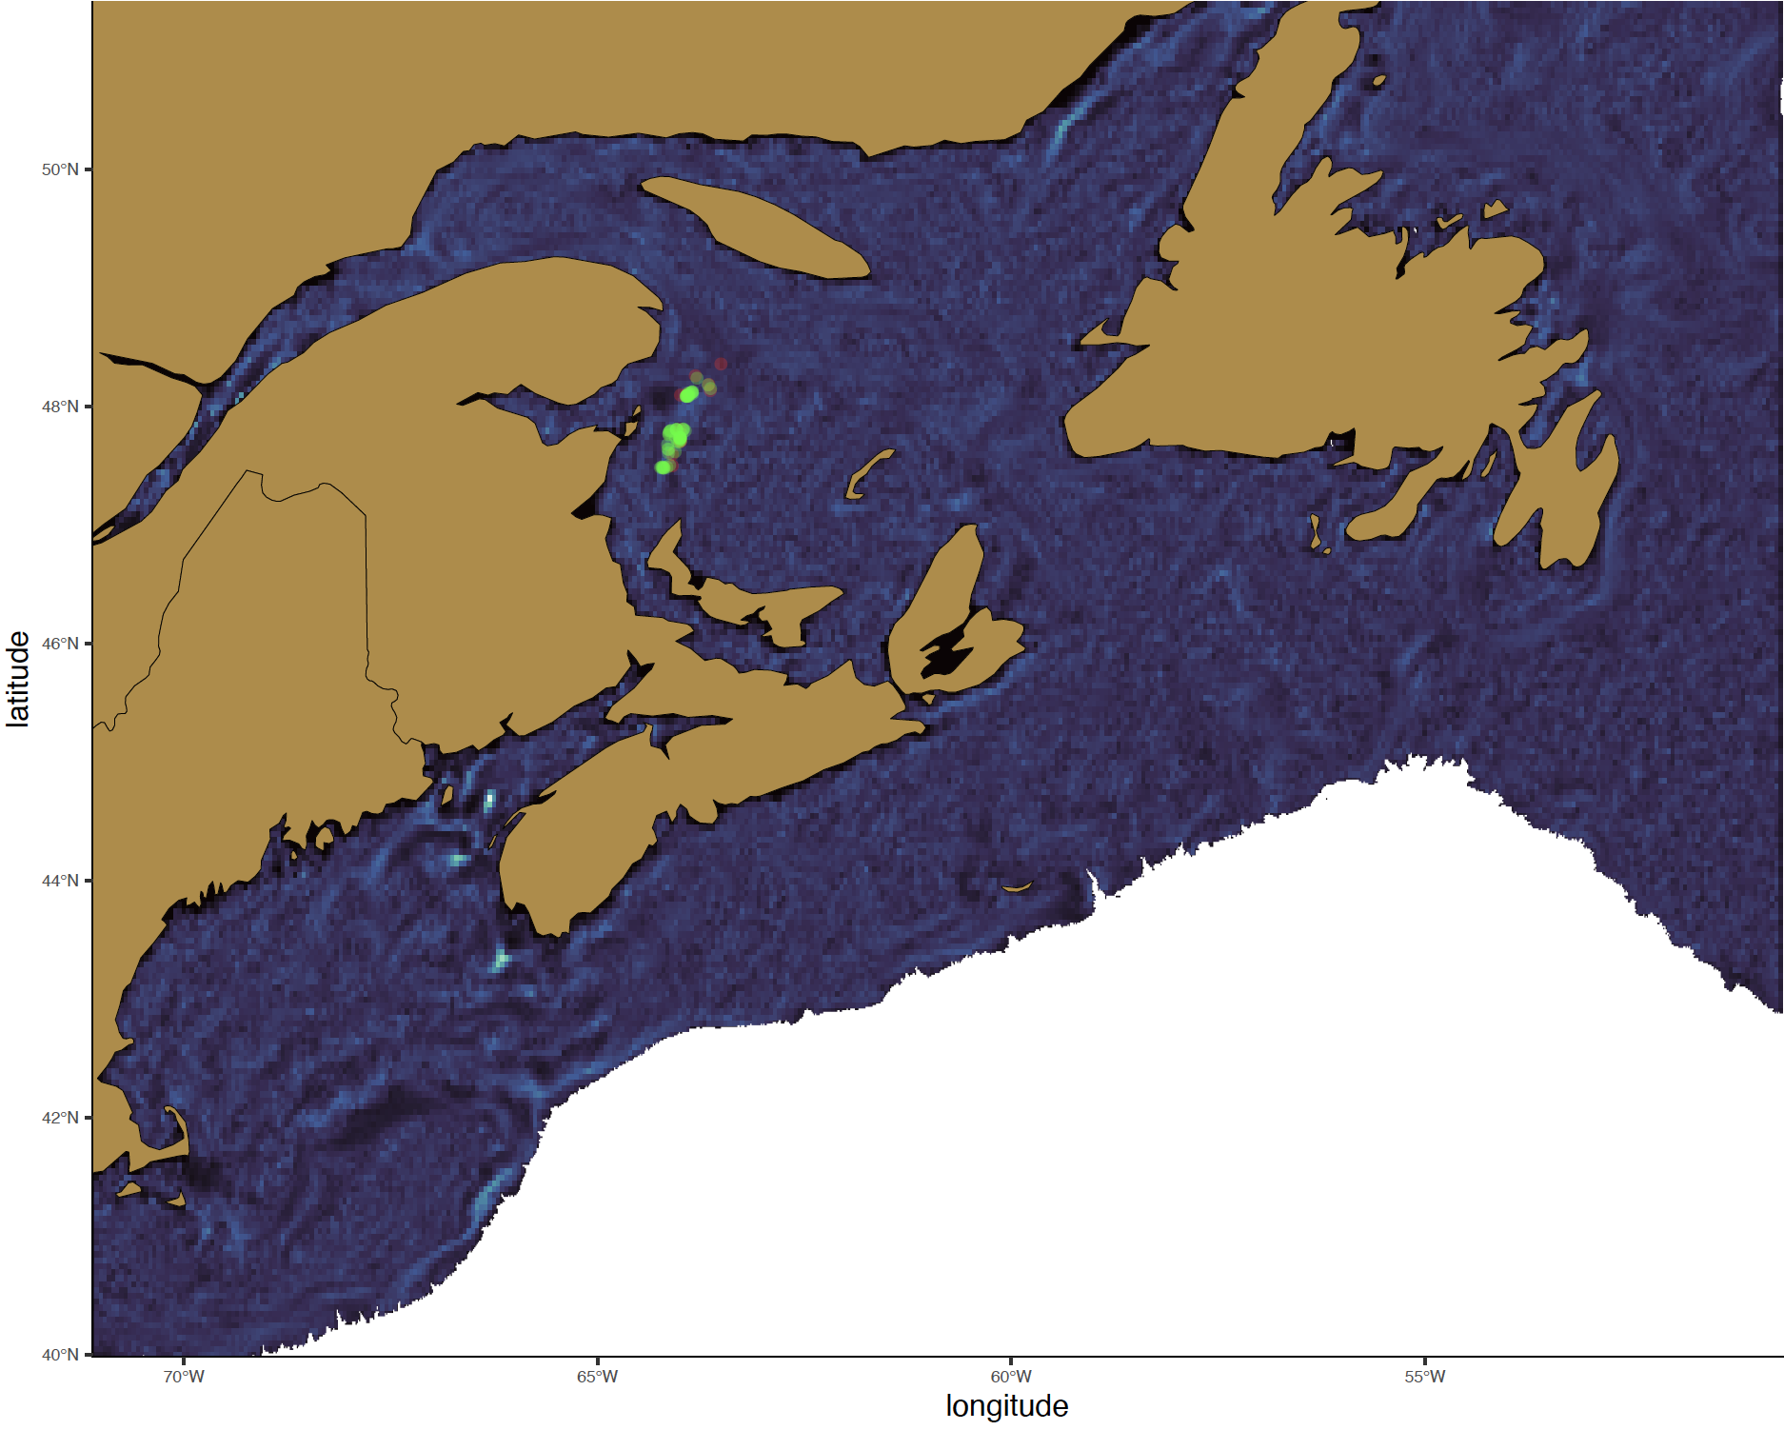
2018
June - 25
Young C. finmarchicus

Slide 11

2018
July - 03
Young C. finmarchicus

Slide 12
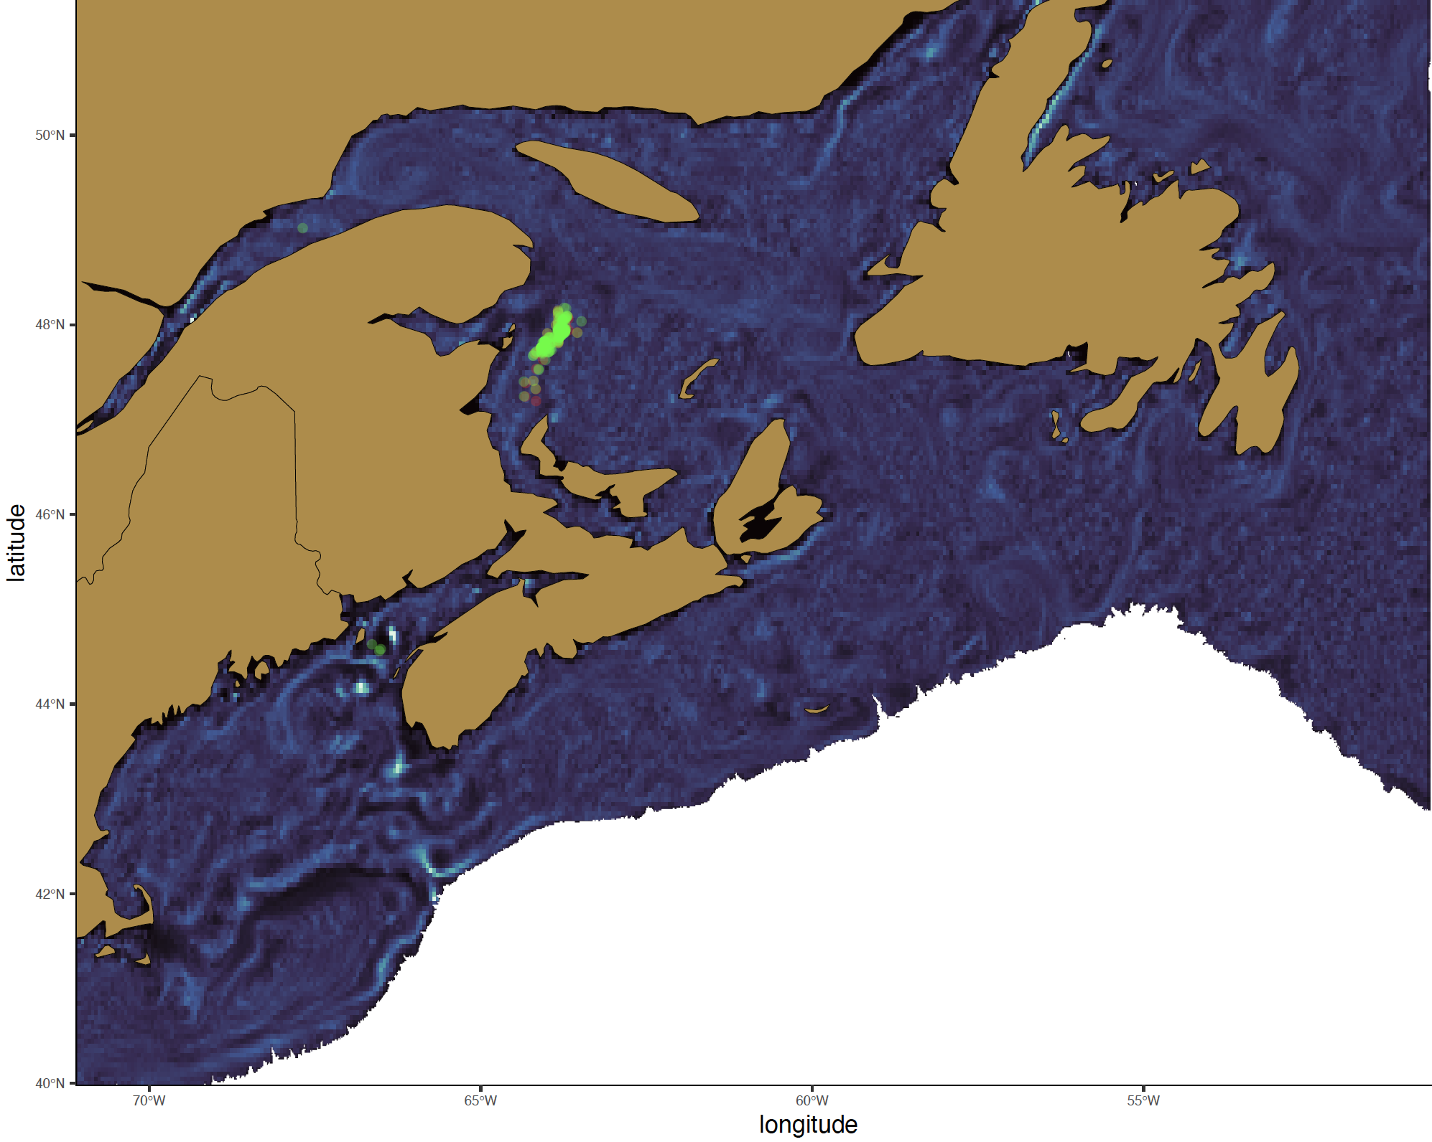
2018
July - 11
Young C. finmarchicus

Slide 13
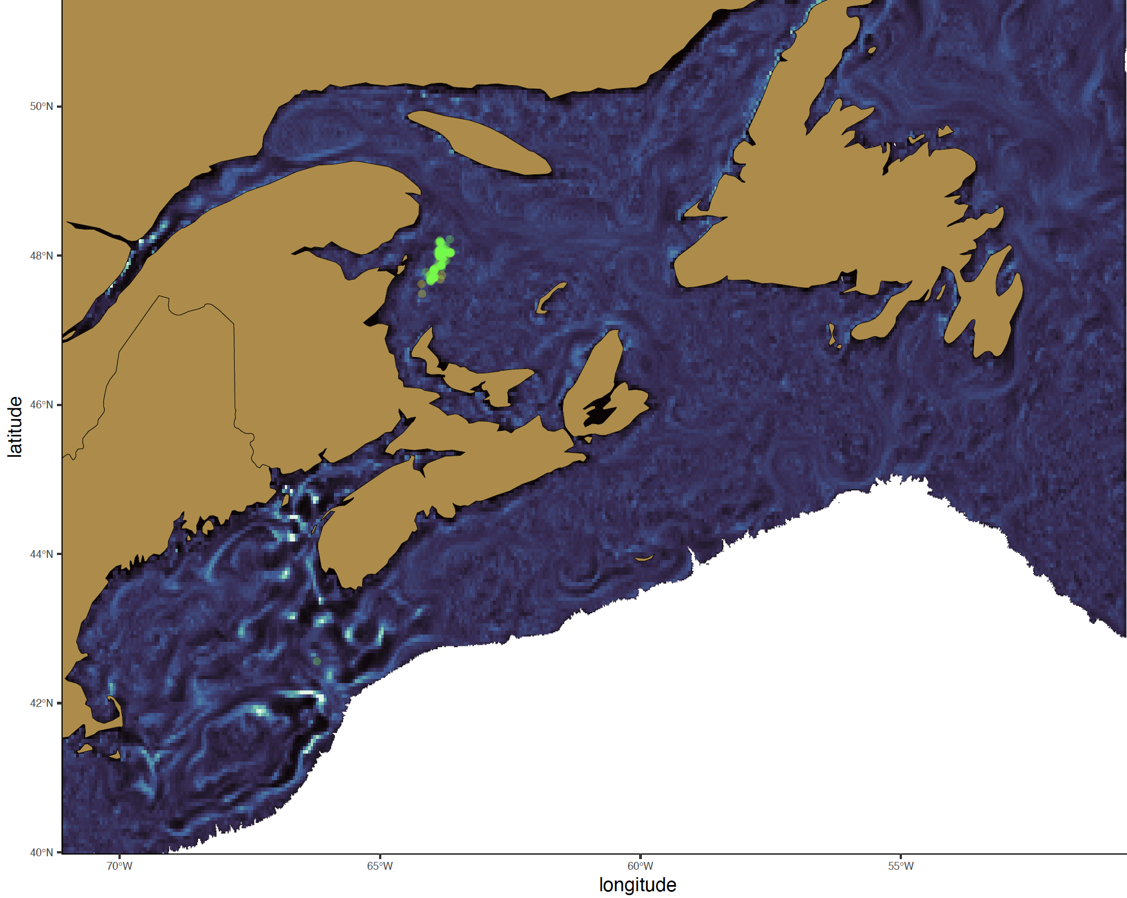
2018
July - 19
Young C. finmarchicus

Slide 14
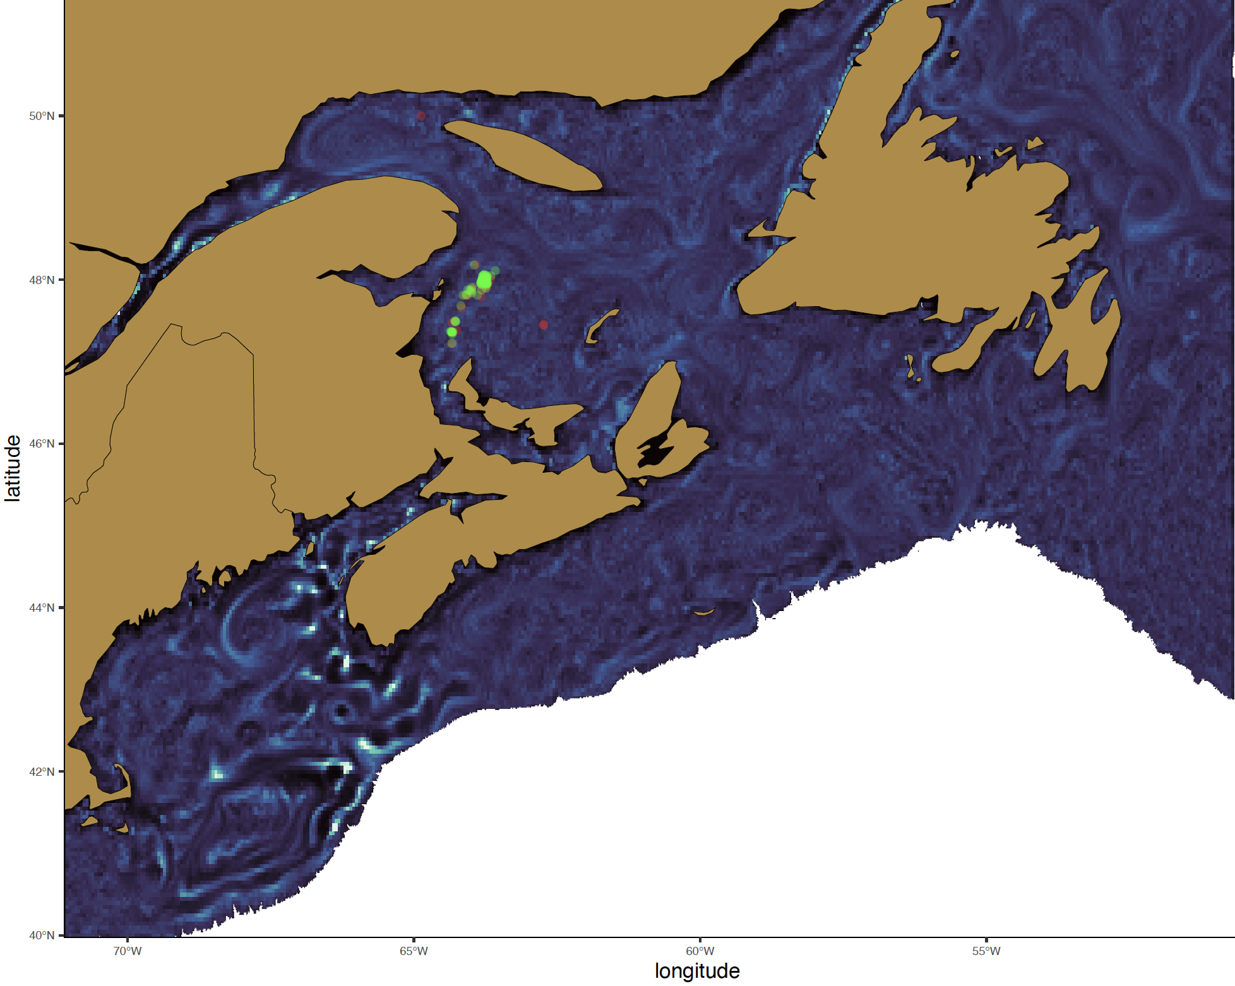
2018
July - 27
Young C. finmarchicus

Slide 15
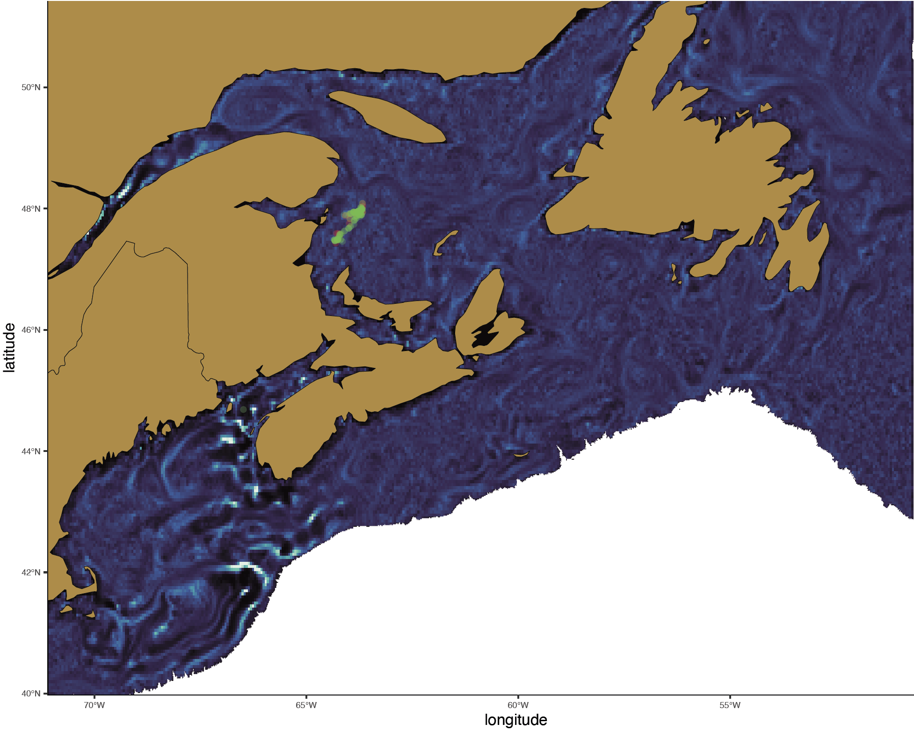
2018
August - 04
Young C. finmarchicus

Slide 16

2018
August - 20
Young C. finmarchicus

Slide 17

2018
August - 28
Young C. finmarchicus

Slide 18

2018
September - 05
Young C. finmarchicus

Slide 19

2018
September - 21
Young C. finmarchicus

Slide 20

2018
September - 29
Young C. finmarchicus

